Slide 1



MNKernel: Unikernel Support for Mininet
SIGCOMM Hackaton 2018 @ Nokia Skypark, Budapest
Alexander Jung Michał Król Torsten Runge (supervised by Bob Lantz)
Budapest, 25 August 2018

Slide 2
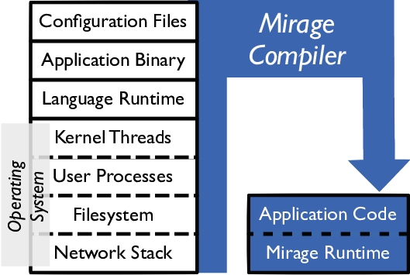
What are unikernels?
Unikernels are specialized, single-address-space machine images constructed by using library operating systems
Unikernels run directly on a hypervisor or on bare metal
Unikernels run more cheaply, more securely and with finer control than with a full software stack

Slide 3
Benefits of Unikernels
Improved security
Unikernels reduce the amount of code deployed, which reduces the attack surface, improving security.
Small footprints
Unikernel images are often orders of magnitude smaller than traditional OS deployments (e.g. 5.2 MB instead of 900 MB)
Highly optimized
The unikernel compilation model enables whole-system optimization across device drivers and application logic
Fast Boot
Unikernels can boot extremely quickly, with boot times measured in milliseconds
Unikernels are a promising technology for implementing edge applications!

Slide 4
Mininet
Mininet is a network emulator which creates a network of virtual hosts, switches, controllers, and links
Provides a simple and inexpensive network testbed for developing network applications
Enables complex topology testing, without the need to wire up a physical network
Includes a CLI that is topology-aware for debugging or running network-wide tests
Supports arbitrary custom topologies, and includes a basic set of parametrized topologies
provides a straightforward and extensible Python API for network creation and experimentation
However, there is no support for running Unikernels on Mininet hosts.

Slide 5
MinKernel Challenge
How to run unikernels in mininet hosts and connect them?
Instantiate a Unikernel
Deallocate a Unikernel
Networking (set IP, set MAC)
Unikernel binary example
Example script / Demo
Documentation
Presentation

Slide 6
Testbed Setup
s1
Mininet Master
(running on Host OS)
s2
10.1.0.1
s3
10.2.0.1
Mininet Host
(running Unikernel)
Mininet Host
(running Unikernel)

Slide 7
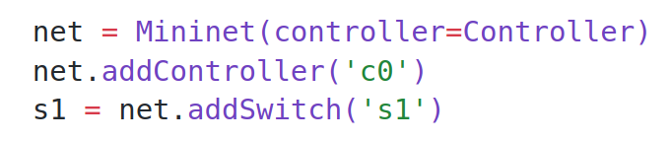
Code Snippet

Slide 8
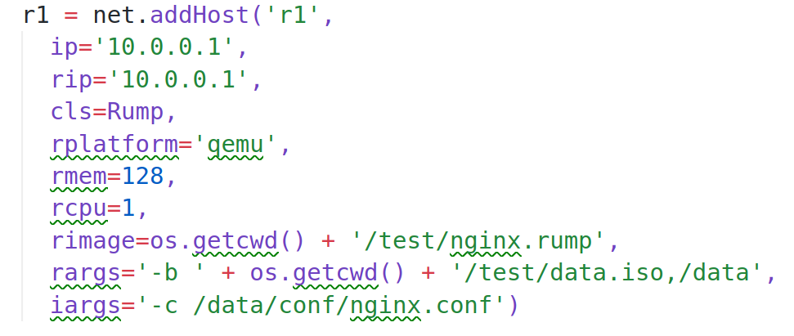
Code Snippet (II)

Slide 9
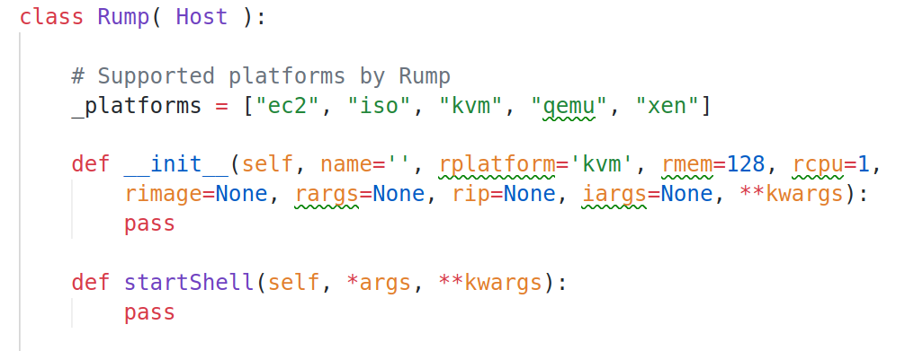
Code Snippet (III)

Slide 10
Code Snippet (IV)
rumprun qemu -i -M 128 \
-I if,vioif,'-net tap,script=no,ifname=tap0'\
-W if,inet,static,10.0.120.101/24 \
-b ./data.iso,/data \
-- ./nginx.rump -c /data/conf/nginx.conf

Slide 11
Summary
Unikernels are an emerging technology for running edge applications
We implemented MinKernel as an mininet extension to run mininet hosts with unikernels
We successfully tested and evaluated MinKernel in a mininet environment
https://github.com/nderjung/mininet
Branch: devel/rump

Slide 12
Demo

